Slide 1
MOOC to Degree with Illinois Tech
Deep dive on MOOC upgrade process for Illinois Tech degrees on Coursera
November 7, 2024

Slide 2
Agenda
1 | Introductions
2 | What is a MOOC (Massive Online Open Content)?
3 | The basics of upgrading to an Illinois Tech degree
4 | Key dates and enrollment next steps

Slide 3
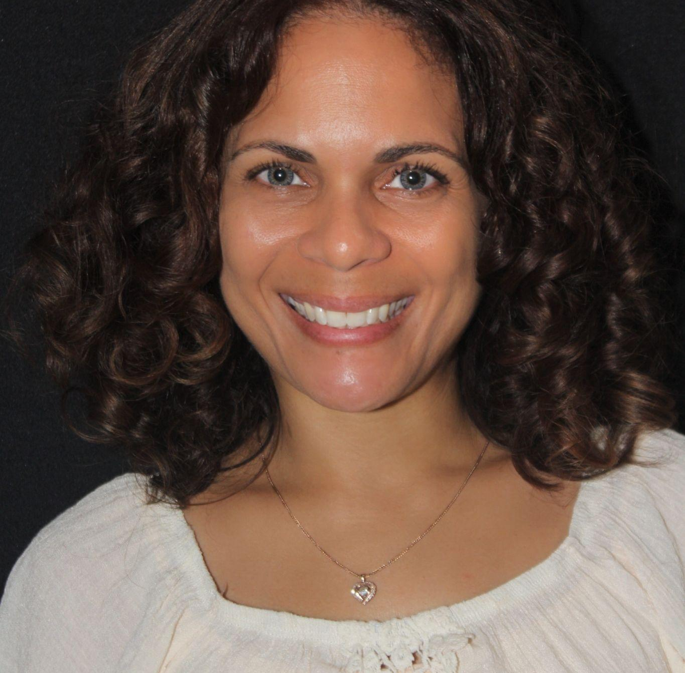
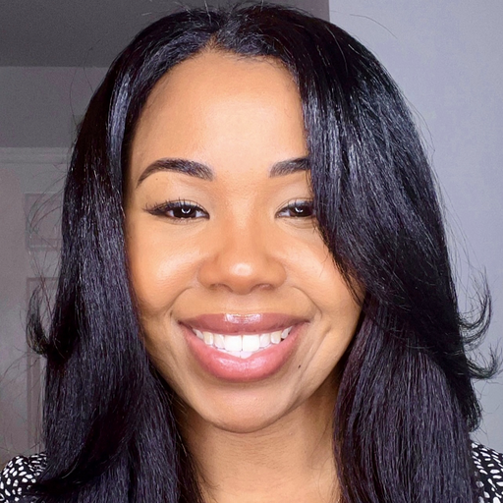
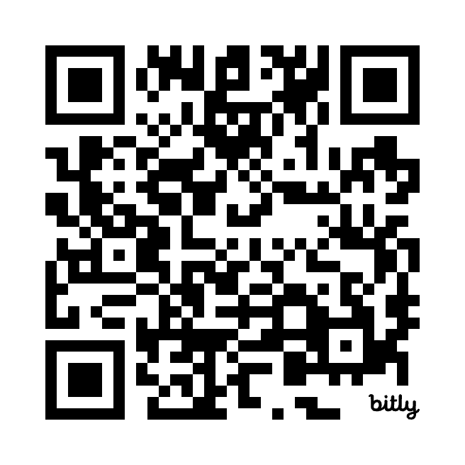
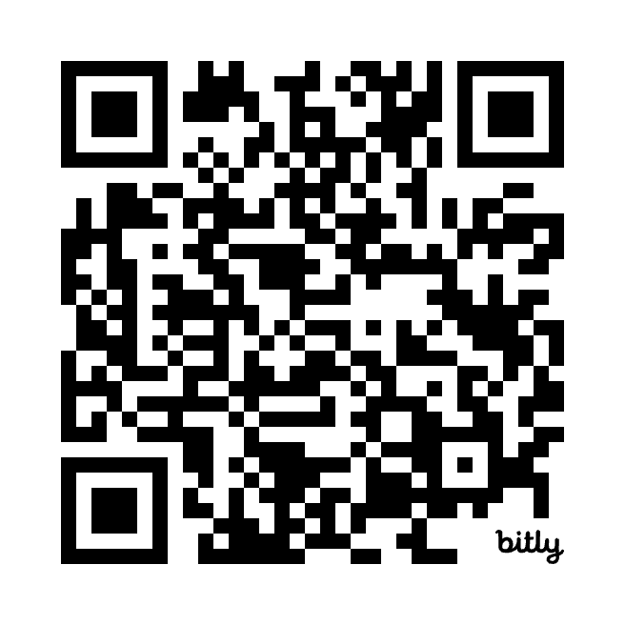
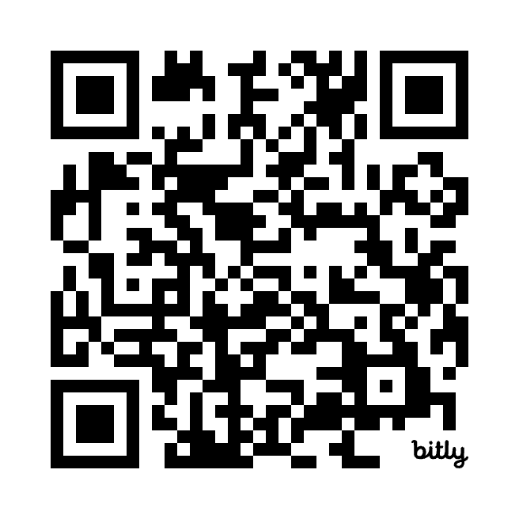
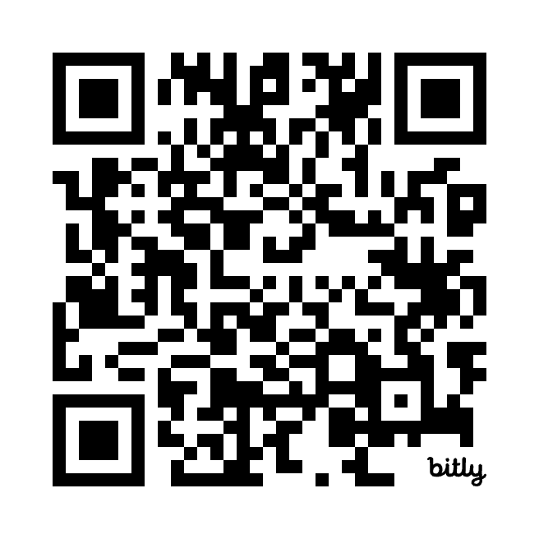
Introductions
Your enrollment support at Coursera
Aida Rodriguez-Nieves
Enrollment counselor
M.B.A. and DS
India Vieira
Enrollment counselor
Bach-IT and M.A.S. IT
M.B.A. Booking Link
Master of Data Science Booking Link
Master of IT Booking Link
Bachelor of IT Booking Link

Slide 4
Did you know that your progress in the Illinois Tech online course you’re enrolled in counts toward a degree?
Poll
Notes:
Yes
No

Slide 5
What is a MOOC?
A MOOC (or Massive Open Online Course) is an online course that is open for anyone to join. These courses are often standalone opportunities to learn more about a specific subject area—and are not always attached to a degree.
That’s different with Illinois Tech online courses on Coursera!

Slide 6
How are Illinois Tech MOOCs different?
If you are enrolled in one of Illinois Tech’s online courses on Coursera—you’re making progress toward an Illinois Tech degree.
Most Illinois Tech’s degree courses are available as MOOCs, so if you decide to enroll using your Coursera Plus account and start these courses—you can simply upgrade your coursework for degree credit!
Not a Coursera Plus member? Sign up for your 7-day free trial today!

Slide 7
How does this work?
Sign up for an MOOC
Find and enroll in an Illinois Tech MOOC. Complete required modules with at least an 80 percent.
Upgrade your course
Go to Illinois Tech’s Coursera portal to enroll and pay tuition for the credit version of the MOOC course.
Finish extra material
To receive credit, you will need to complete additional learning/modules, as well as a summative assessment.
You will need to finish your three (for-credit) performance pathway courses FIRST, prior to being able to upgrade other courses for degree credit.

Slide 8
Upgrade your PBA courses first
While most of Illinois Tech’s degree courses are available as MOOC, you will first need to be admitted into the program (complete three performance pathway courses listed below) prior to upgrading any other courses for degree credit.
We recommend starting with these courses first:
MBA
Master of Data Science
Master of IT
Bachelor of IT
Competitive Strategy
Intro to Relational Databases
Microsoft Windows OS
Computer & Peripheral Hardware
Managerial Economics
Linear Regression
Linux OS
Computer Networking
Mastering Excel Essentials
Model Diagnostics & Rem. Measures
OS Security
Mobile Computing and Cloud
OR
Relational Database Design

Slide 9
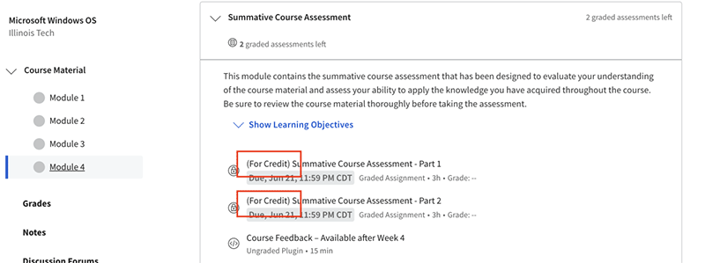
Register and pay tuition to gain access to your for-credit course
In order to upgrade your course, you will need to enroll and register for the “for-credit” version of the course(s). Upon paying your tuition, you will then be prompted to complete additional modules and/or complete a summative assessment.
Failure to complete the for-credit summative assessment will result in course failing. Any course retake will require a new registration and tuition payment.
All completed required assignments will be transferred to the credit course. You can review the checklist, once enrolled, to ensure you complete all required modules and assessments.

Slide 10
MOOC learners have more time!
As someone enrolled in the MOOC version of the course, you will have up until the fifth week of the academic term to upgrade and get credit for that session.
Illinois Tech offers sessions in fall, spring, and summer.
Fall B
Start of term: 10/14/2024
Add/drop: 10/21/2024
Last day to upgrade from MOOC: 11/15/2024
Last day to complete all required additional content: 12/6/2024

Slide 11
Resources
[NEED TO ADD DDP QR CODE]
[NEED TO ADD QR CODE FOR IIT SITE]

Slide 12
How many online Illinois Tech courses are you enrolled in?
Poll
Notes:
1
2
3
+3

Slide 13
Questions?

